Slide 1
Group 3 Horizontal Prototype
Lucy, Ekhonmu, Nami, Esther

Slide 2
Recap
We are Globe Trekker, a local travel company based in calgary that is building a web application for tourists coming to Calgary
Globe Trekker offers features like destination and event recommendations, itinerary planning, price comparisons for different activities, and access to local amenities and emergency services.
Globe Trekker is designed for primarily travellers who have not been to Calgary before, or users that are looking to experience new things in the city.

Slide 3
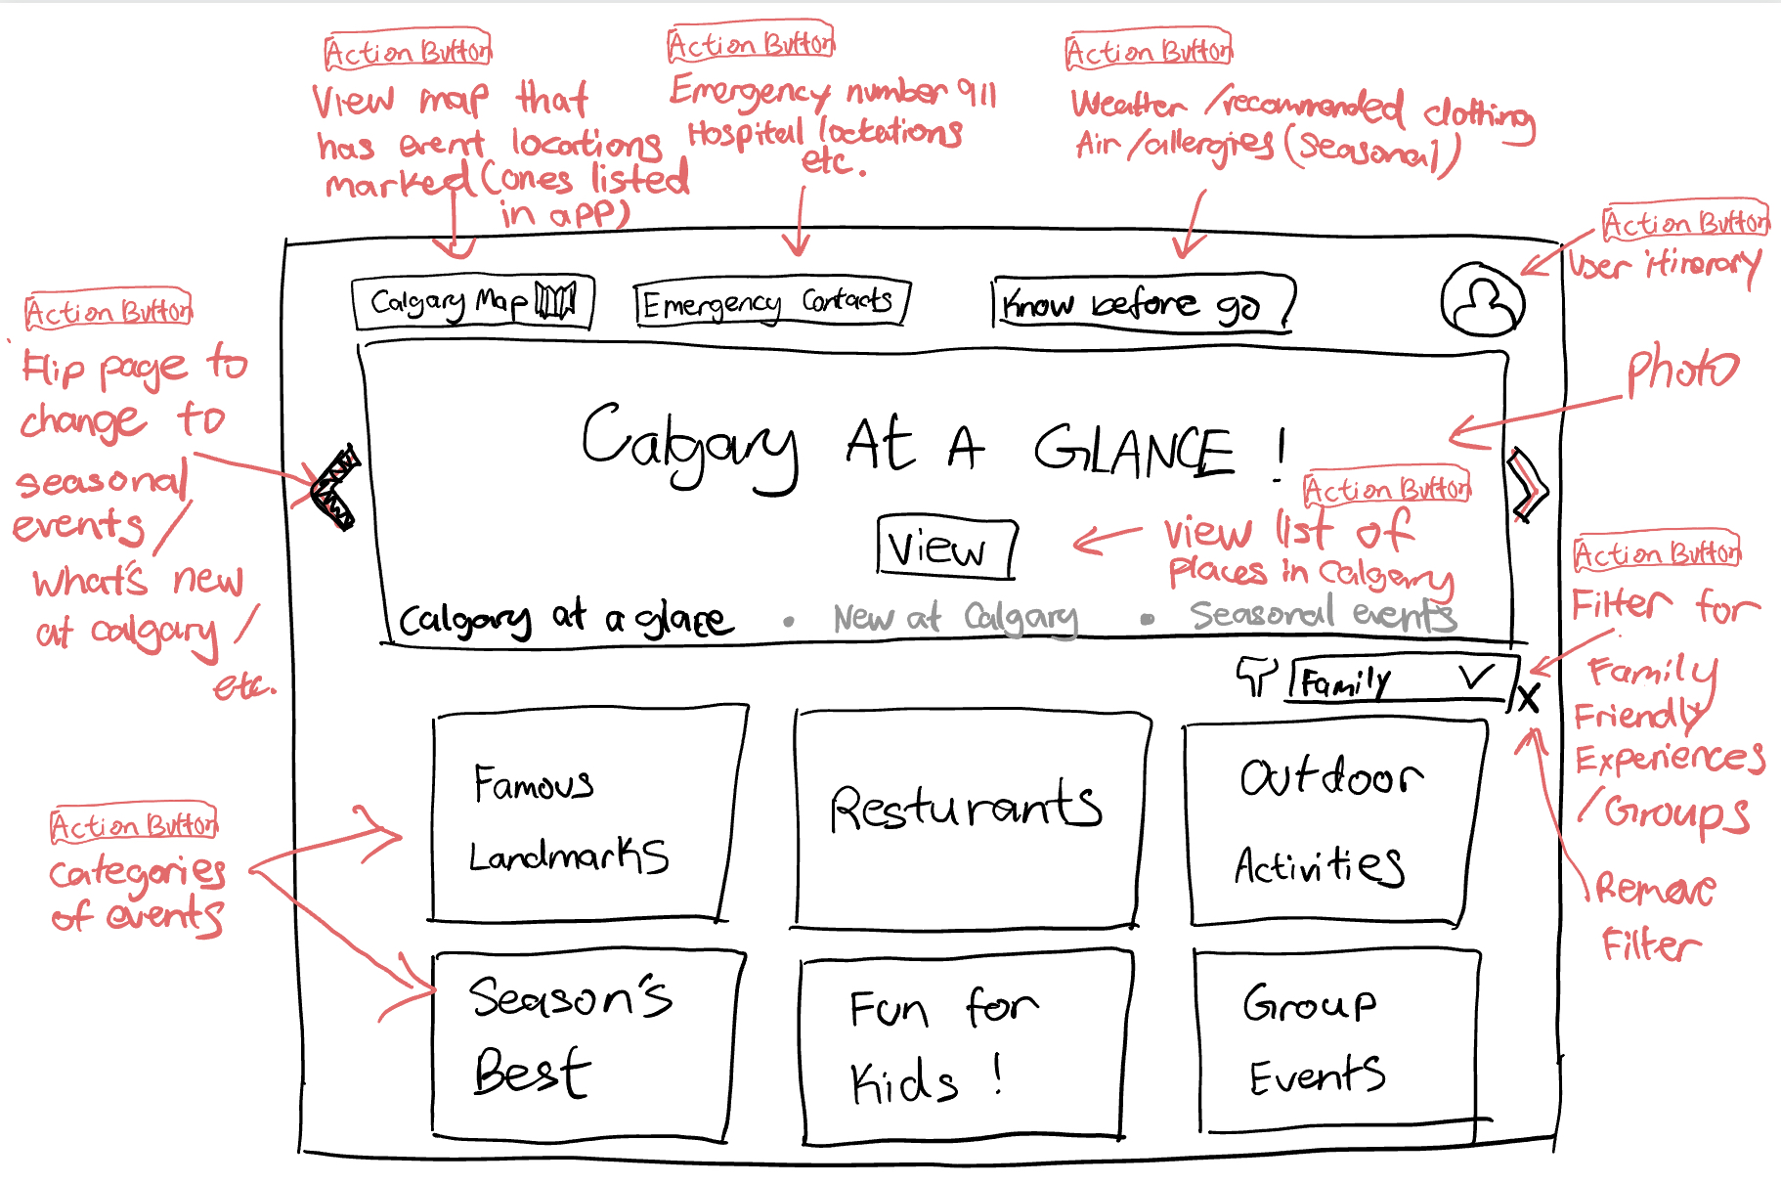
Recap

Slide 4
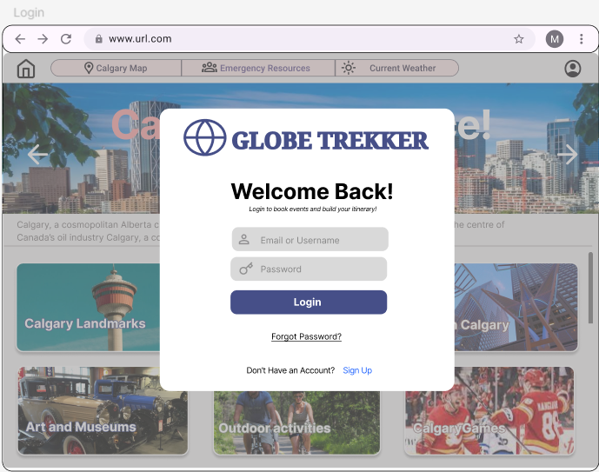
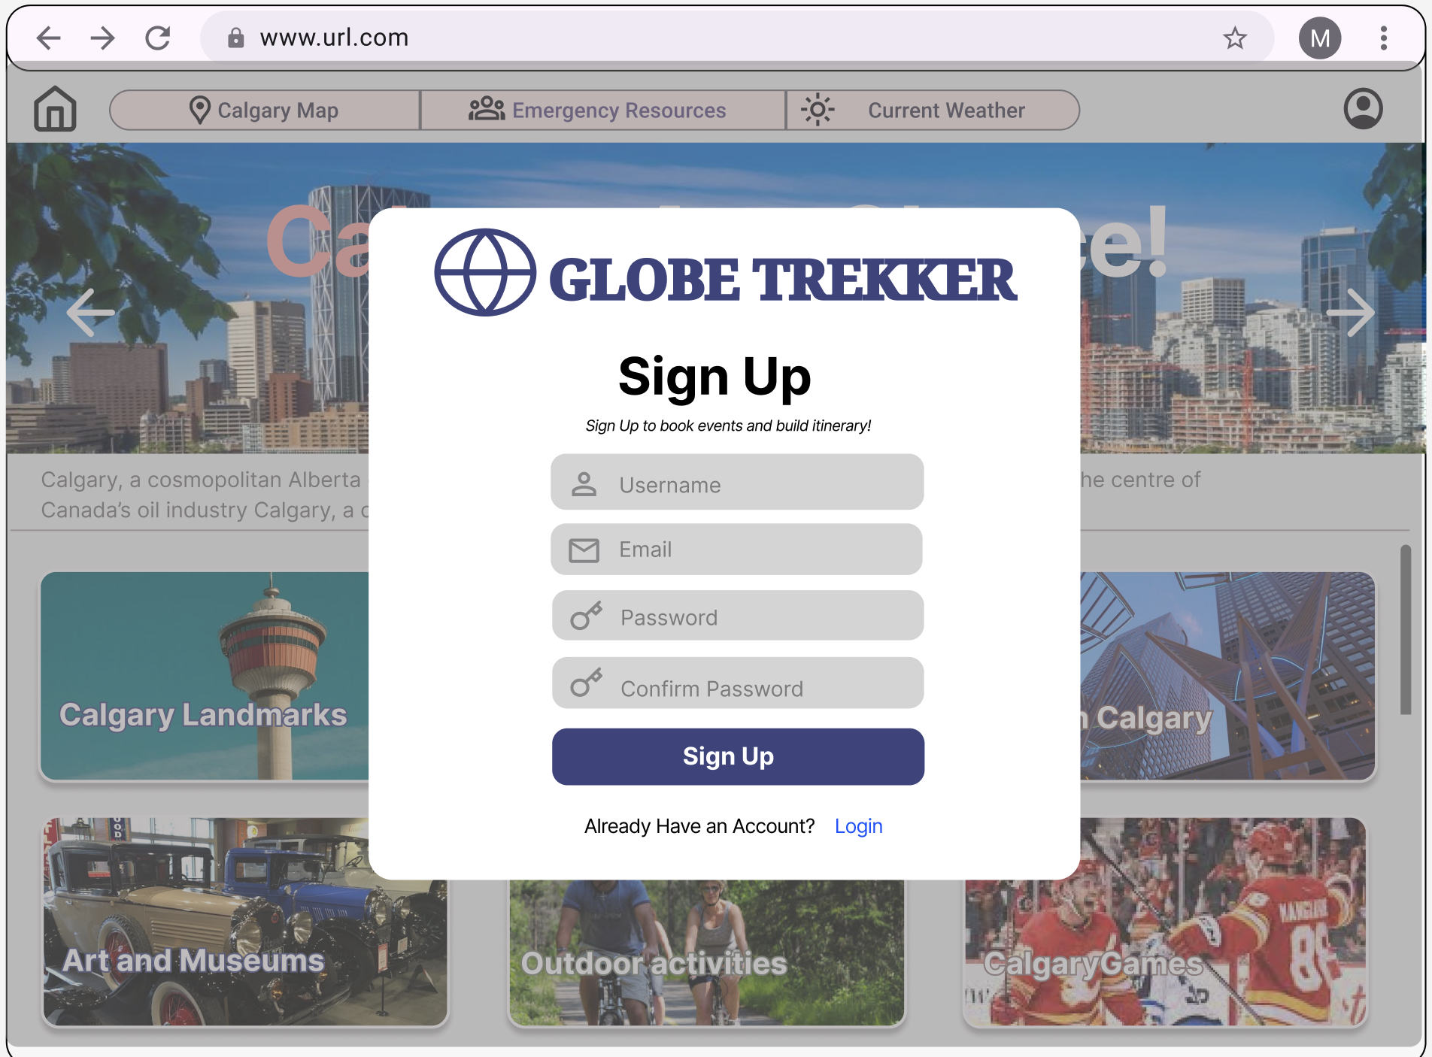
Screenflow - Login/Sign Up Screen

Slide 5
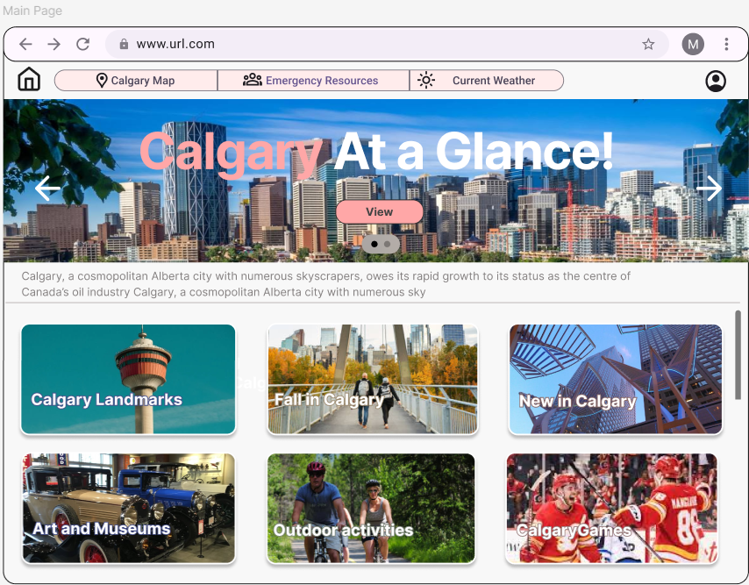
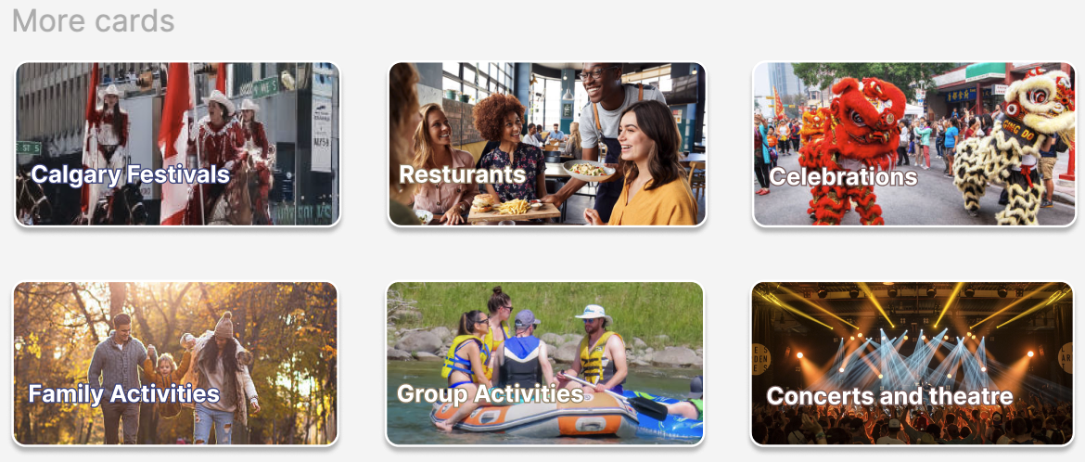
Screenflow - Main Page(Scrollable)

Slide 6
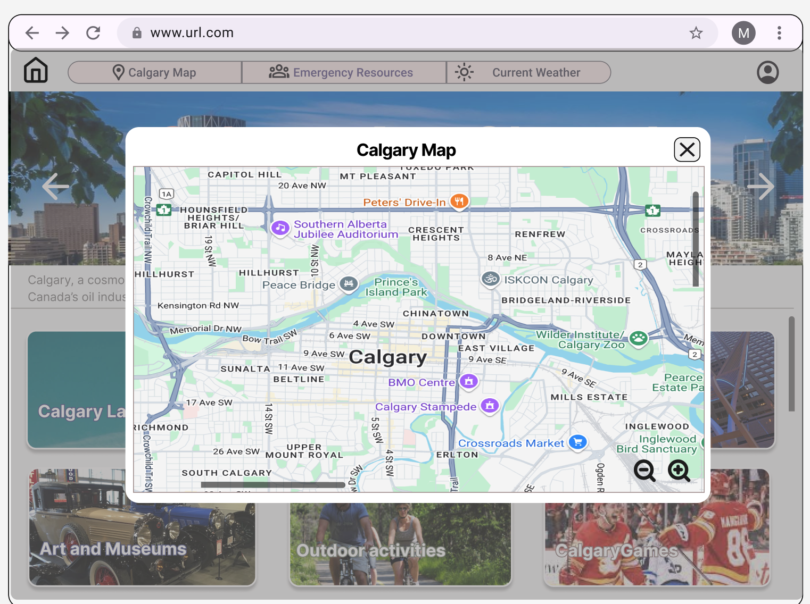
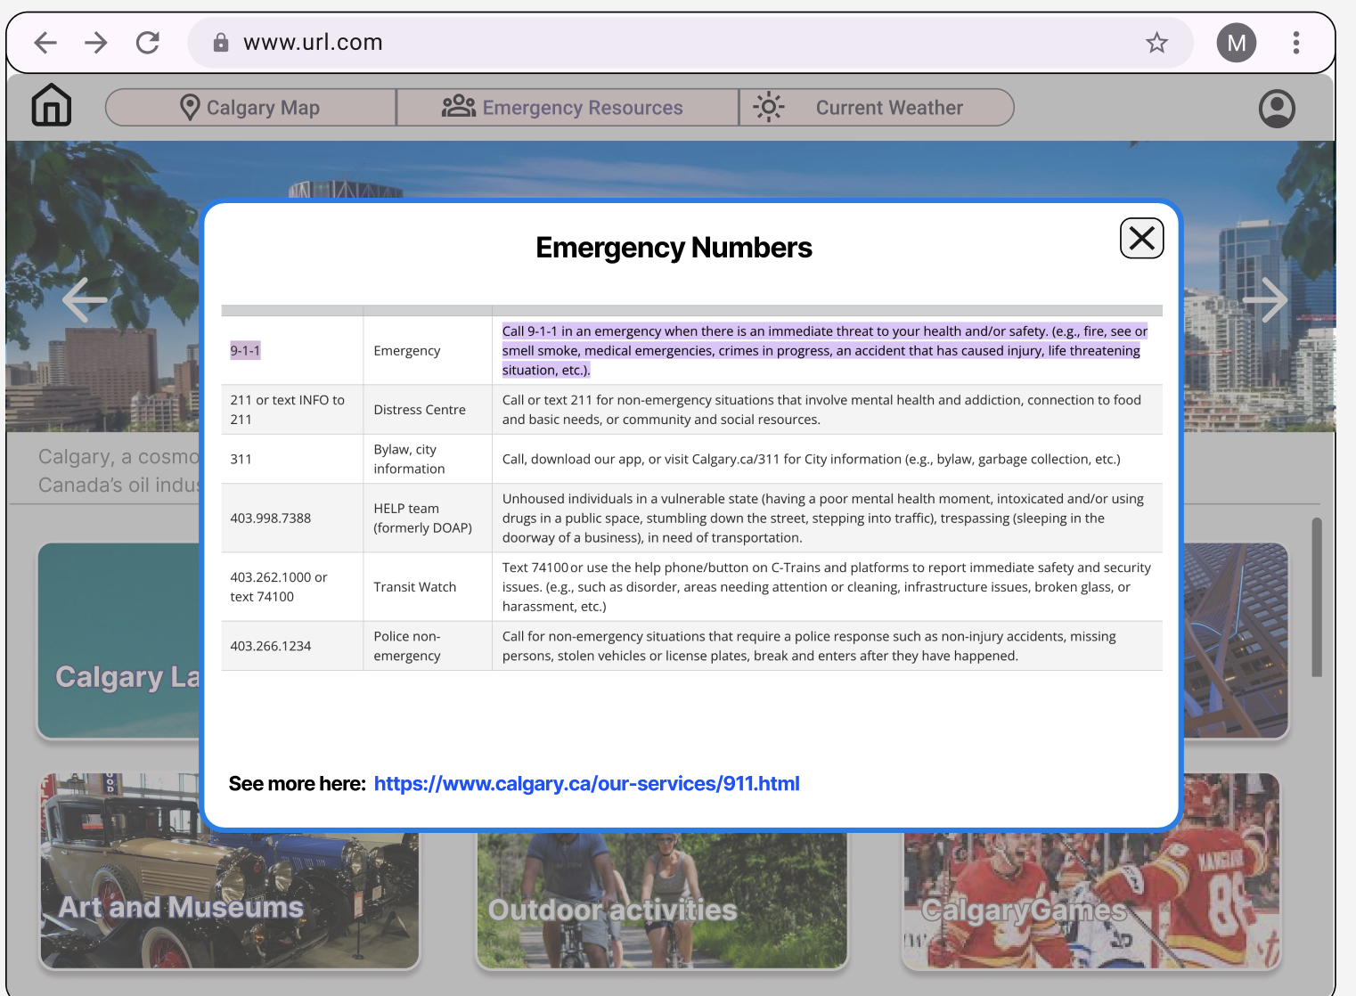
Screenflow - Navbar buttons

Slide 7
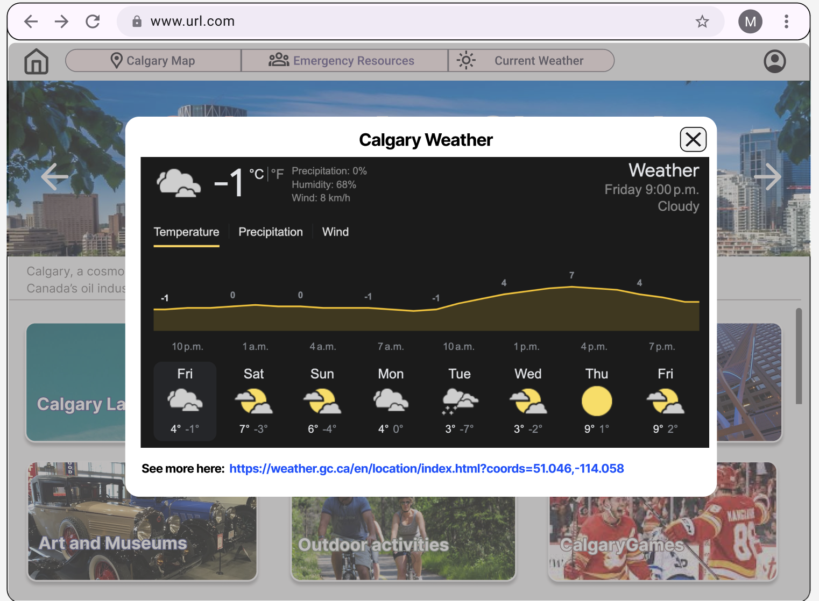
Screenflow - Navbar buttons(Cont.)

Slide 8
Screenflow - Main Page(Scrollable)

Slide 9
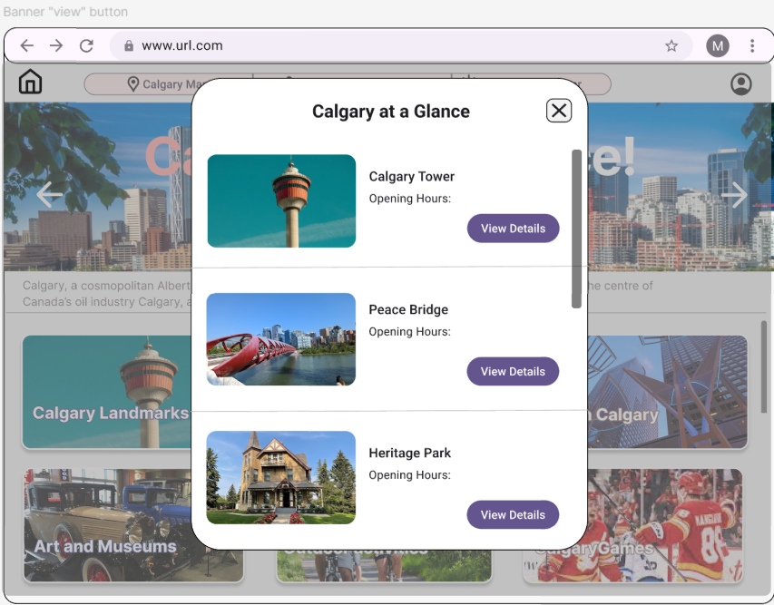
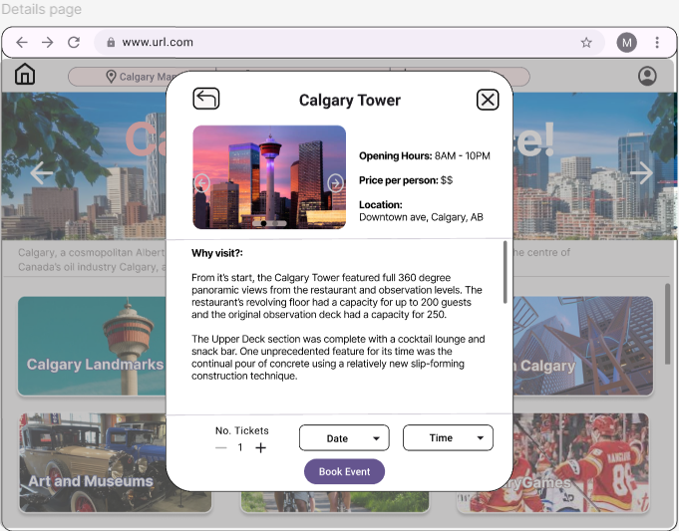
Screenflow - Banner “view” button popup

Slide 10
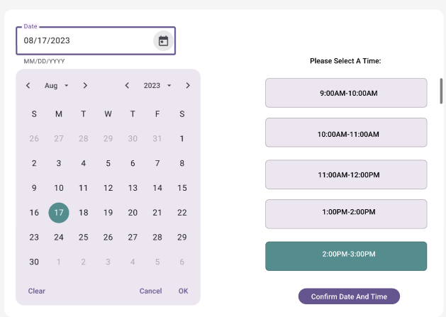
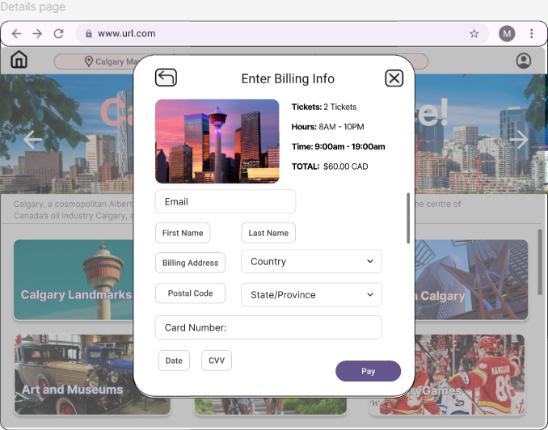
Screenflow - Banner “view” button popup (Cont.)

Slide 11
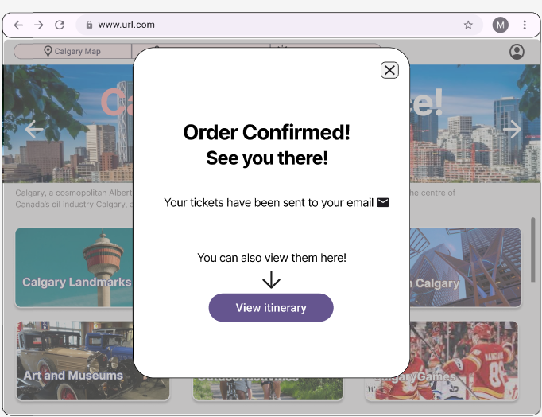
Screenflow - Banner “view” button popup (Cont.)

Slide 12
Screenflow - Main Page(Scrollable)

Slide 13
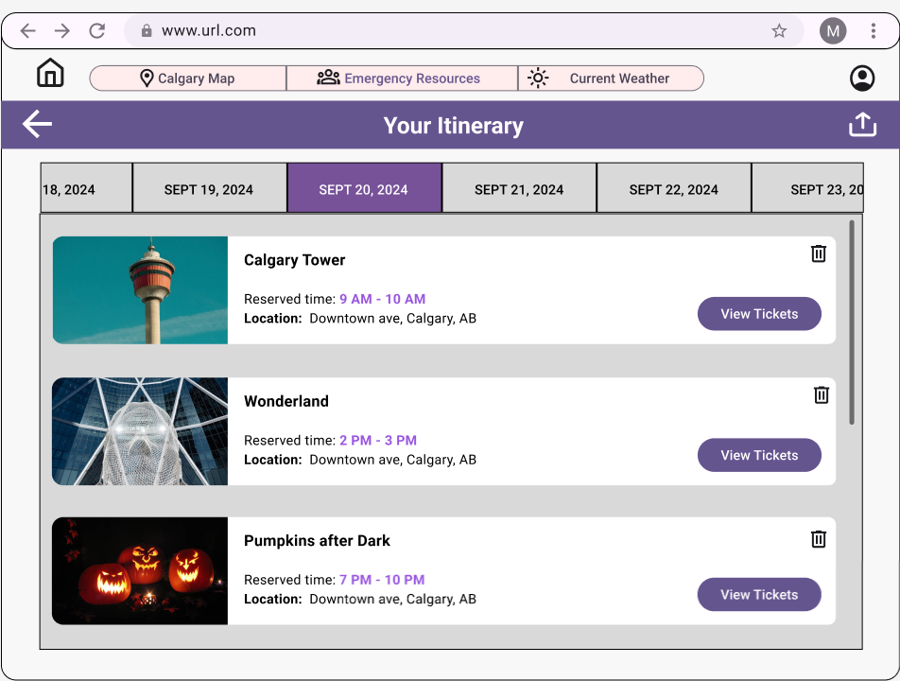
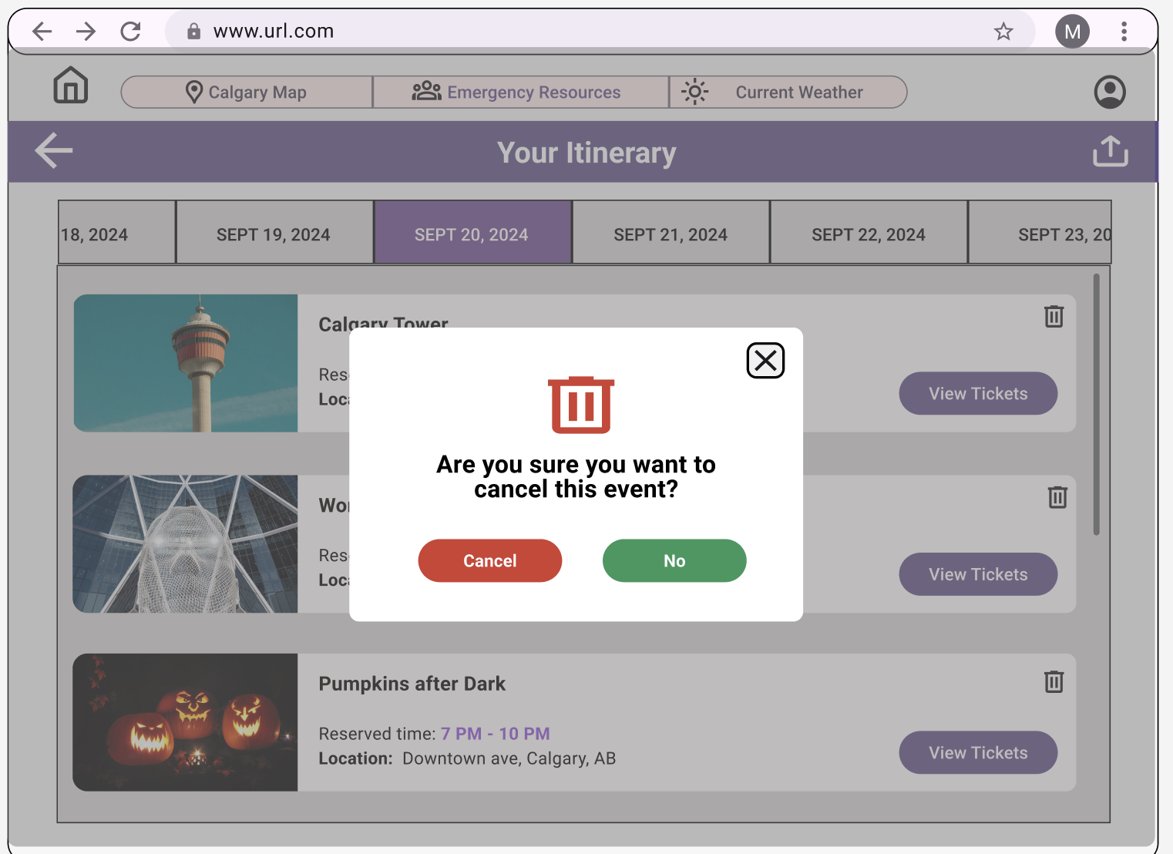
Screenflow - Itinerary

Slide 14
Screenflow - Main Page(Scrollable)

Slide 15
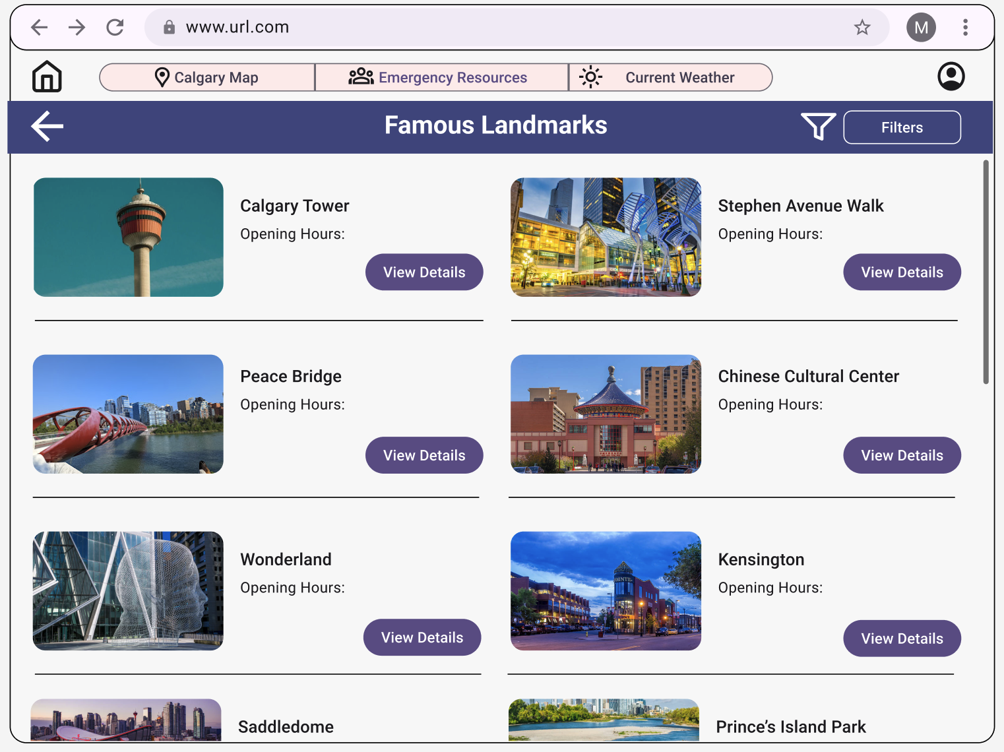
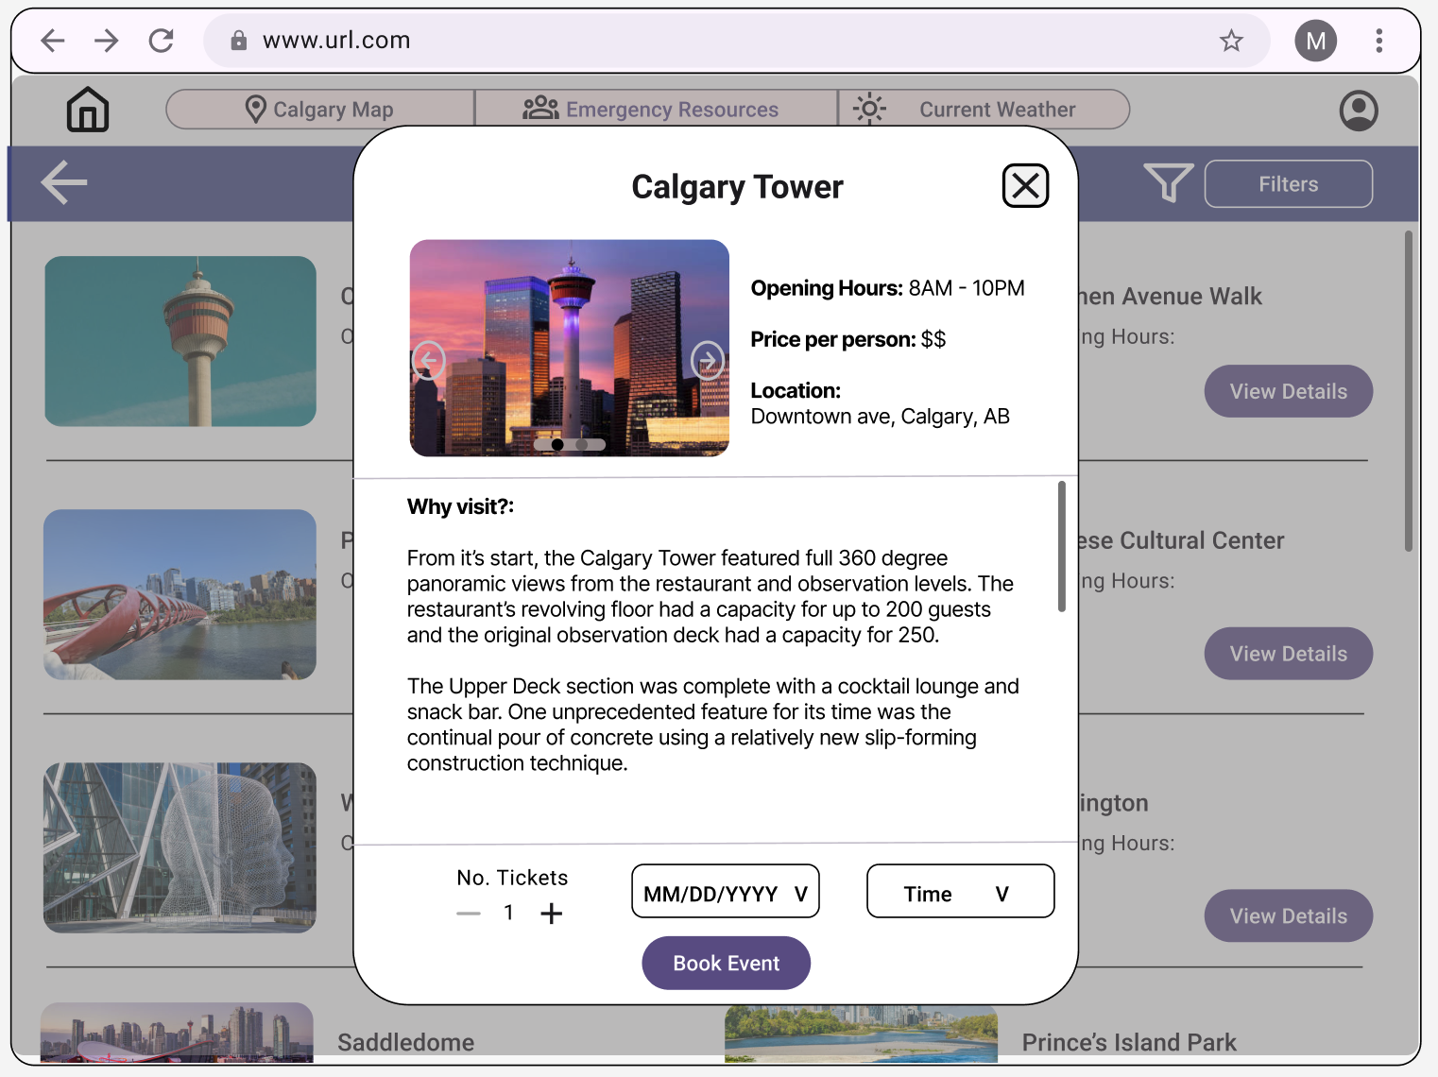
Screenflow - Category buttons

Slide 16
Discussion
Why we made these changes?
We wanted both users and non-users to be able to see what categories Globe Trekker has to offer first without signing up.
We wanted the user to be able to navigate with as little internal questions as possible.
We also used “pop-ups” as a way to avoid the user having to navigate between many different pages to complete their task.
We colour coded actionable items in purple to match the aesthetic of the website, but the options to remove/cancel an item will be labelled in red.
Itinerary is automatically sorted by date for the user.

Slide 17
Questions?

Slide 18
Thank You!

